Slide 1
Choose
Your
Exit...

Slide 2
It’s been years since the nuclear apocalypse.
You’re safe in your camp.
But you’re all alone.
Until a stranger offers
to take you away...

Slide 3
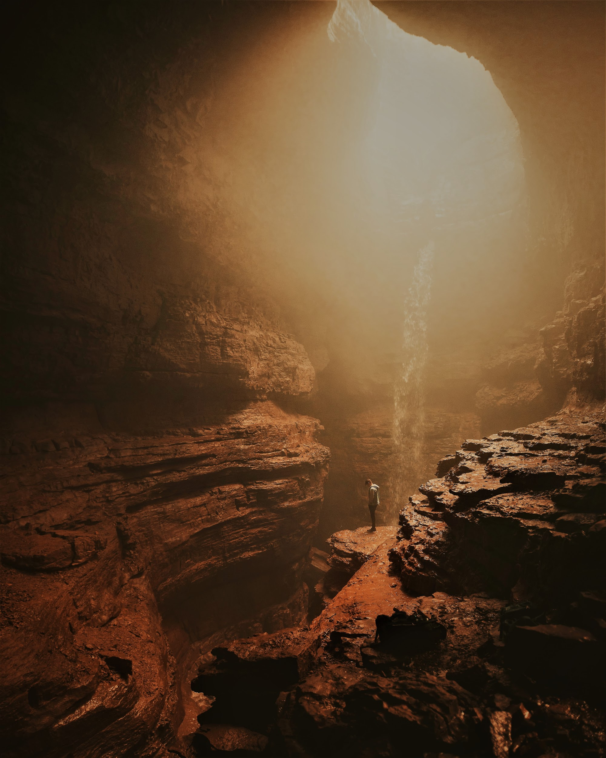
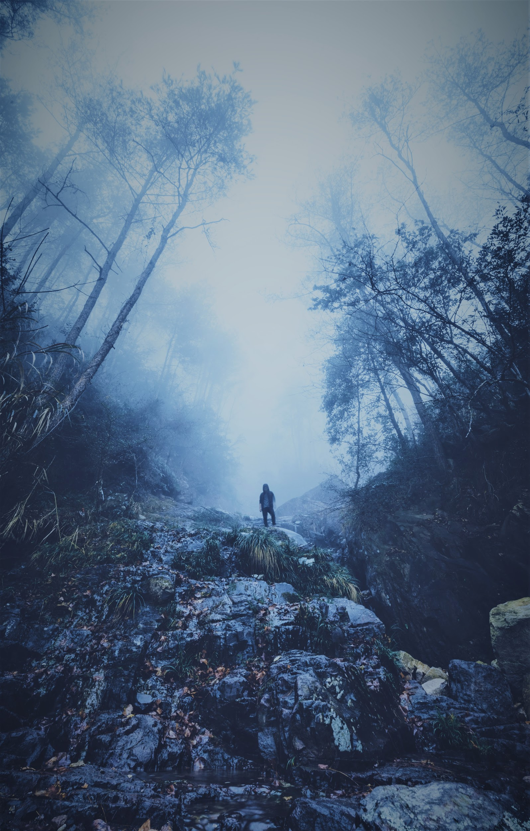
under
ground
above ground
click to choose

Slide 4
You discover a place to make an elaborate underground lair. Soon, others hear of your mighty realm and ask to join.
Join forces
Go it alone

Slide 5
You’re the ruler of a formidable underworld.
Your minions bring you a scary, black substance that makes people vanish.
Gather and stockpile it
Hide it and
run away

Slide 6
The sun never sets here.
The sun never
sets here.
You’re trapped in a simulation!
Try to escape
Tell
others
You’re trapped
in a simulation!

Slide 7
You found some tar! It can force people
to wake--but the shock might kill them.
If you find no other way to wake everyone, you’ll all die in the sim.
Use the tar
Search elsewhere

Slide 8
You rushed it!
The confusion makes a
sticky black substance appear.
Oh no!
Cool!

Slide 9
You find a girl
hiding in a bunker,
but she doesn’t
want to wake.
Examine
the bunker
She wants to take
you to others who
need saving.
Follow
her

Slide 10
You wake to learn you were trapped in a failing simulation. You go back in to help others escape.
Find a group of people to wake
Find one person at a time to wake

Slide 11
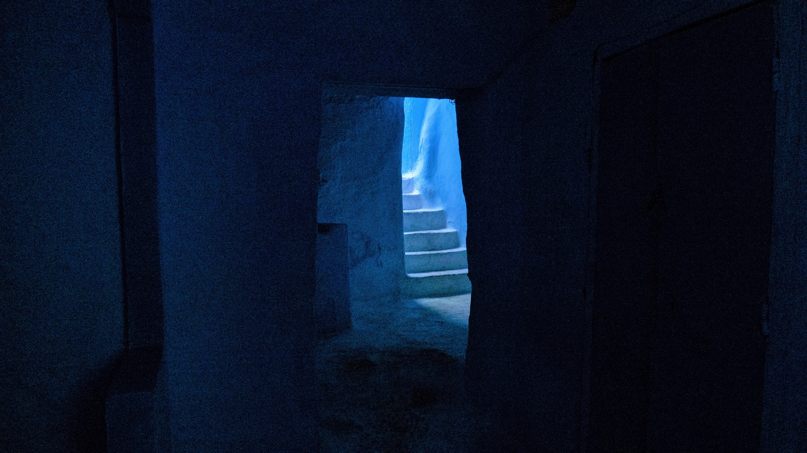
Mementos from life outside the sim might help you wake people.
But you don’t have much time.
Search for mementos
Try without mementos

Slide 12
Try as you might, you can’t escape!
How will you spend your time?
Warning others
Remembering your past

Slide 13
Just when you think you’re safe, you receive a message that none of this is real—
you’re trapped in a failing simulation!
Refuse
to be sabotaged
Flee your doomed city

Slide 14
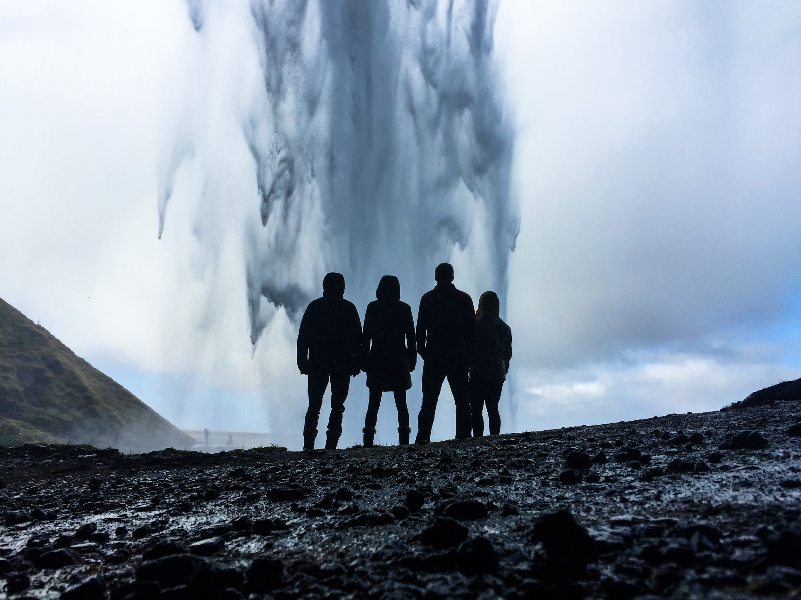
They don’t believe that they’re in a simulation.
You could force them to wake,
but only if you have tar.
Yes
No
Did you find a sticky, black substance?

Slide 15
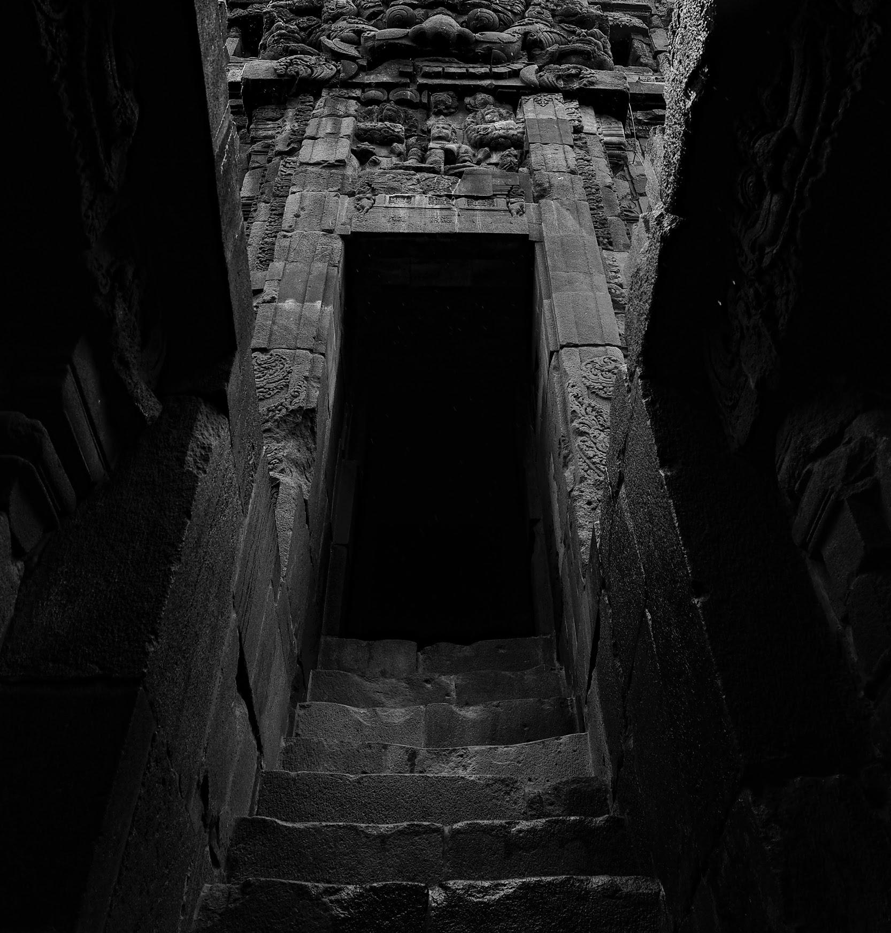
Like Taren, you’re willing
to choose who to save--
and who to sacrifice.
Beware: your exit from
the sim may be a dark one.
Choose again

Slide 16
Like Ransom, you want
others to escape the sim…
even if you never do.
Your exit from the sim is locked, but one day you might
find the key you need.
Choose again

Slide 17
Like Lake, you’re sure you can help others remember the real world and escape the sim.
But your exit gets harder
to find the longer you
stay in the sim.
Choose again

Slide 18
Like Eden, you’re more interested in ruling the sim than in escaping it.
Your exit is buried deep in the sim, but it will be up to you to decide whether to use it.
Choose again

Slide 19
Found an exit?
You’re ready to read the book!

